Slide 1
Tools for Agile Development
Day 4

Slide 2
Outlines
Postman
Slack
Trello
Jenkins

Slide 3

Postman
Download: https://www.getpostman.com/
Notes:
แนะนำตัวโปรแกรม ฟีเจอร์ ละเปรียบเทียบ
เวอร์ชั่น Free vs Pro
https://www.getpostman.com/pricing

Slide 4
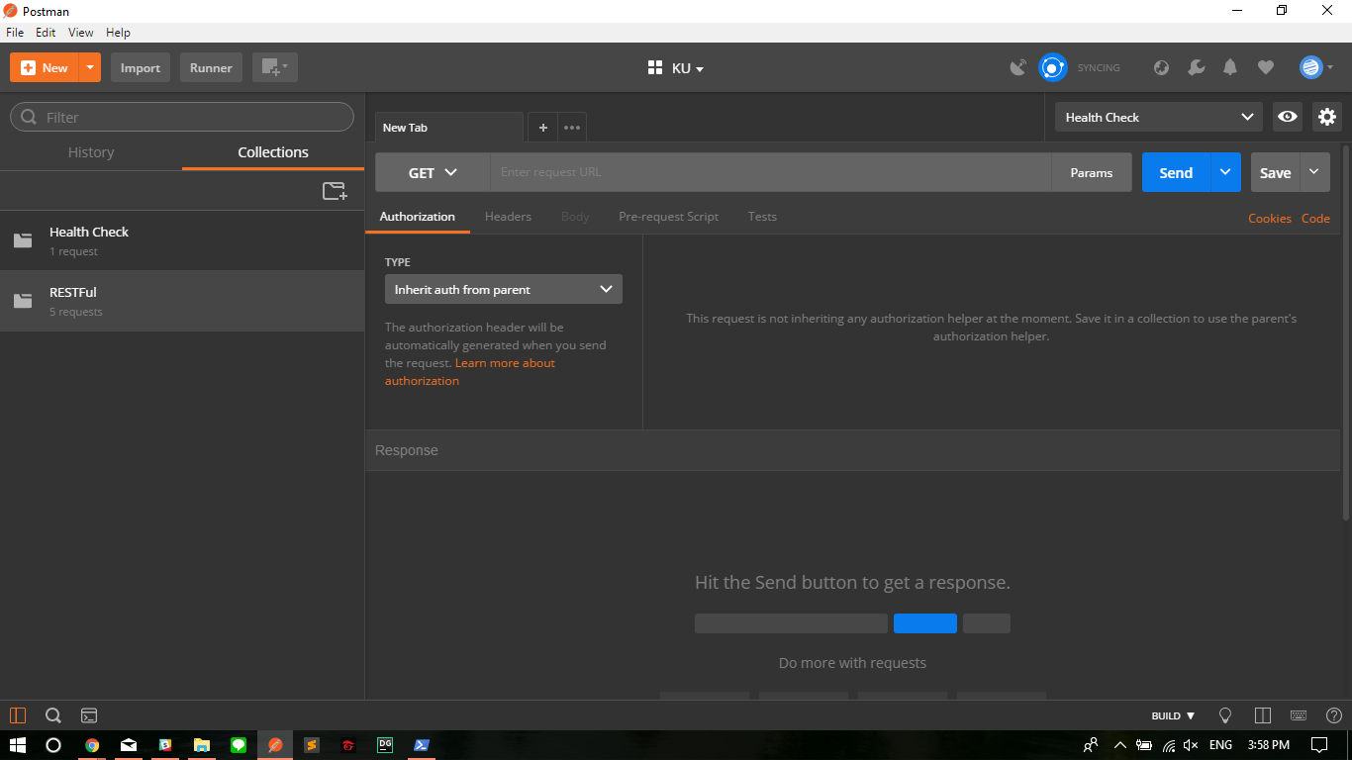

Slide 5
Postman
Create New Workspace
Manage Environment
Create Collection
Create Request
Export and Share Collection
Publish API Document
Write Tests
Mock Request

Slide 6
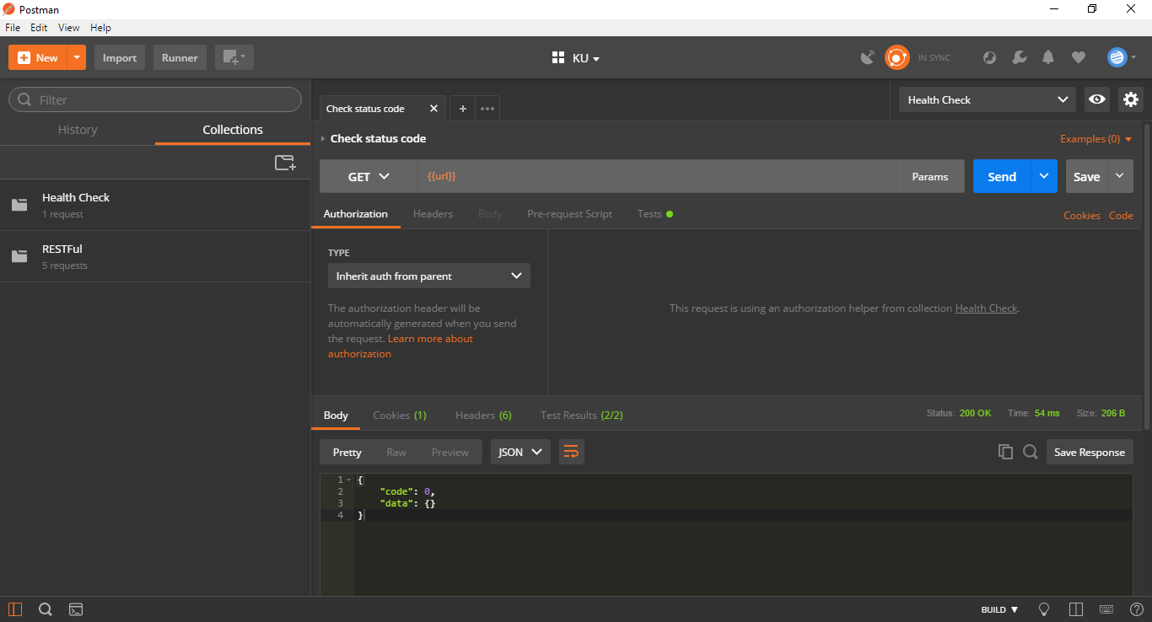
Postman

Slide 7
Postman
Create New Workspace
Manage Environment
Create Collection
Create Request
Export and Share Collection
Publish API Document
Write Tests
Mock Request

Slide 8
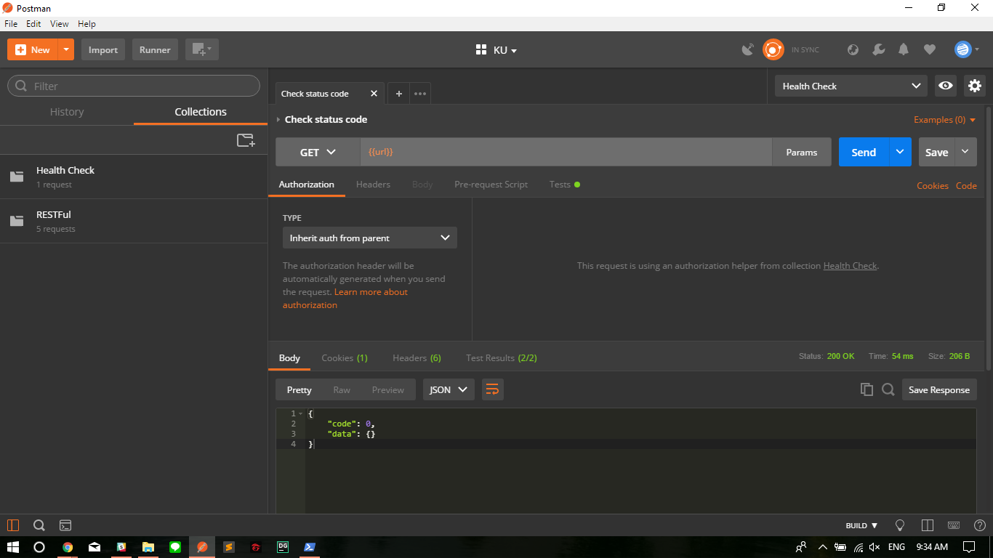

Slide 9
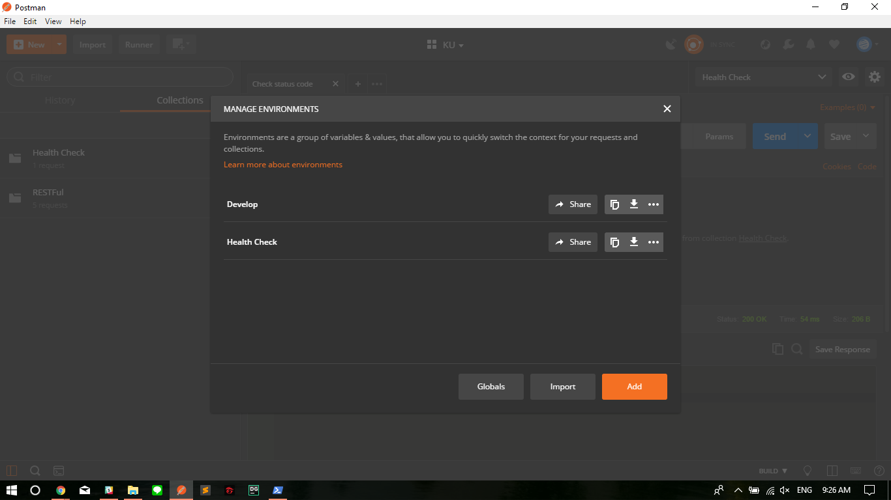
Postman

Slide 10
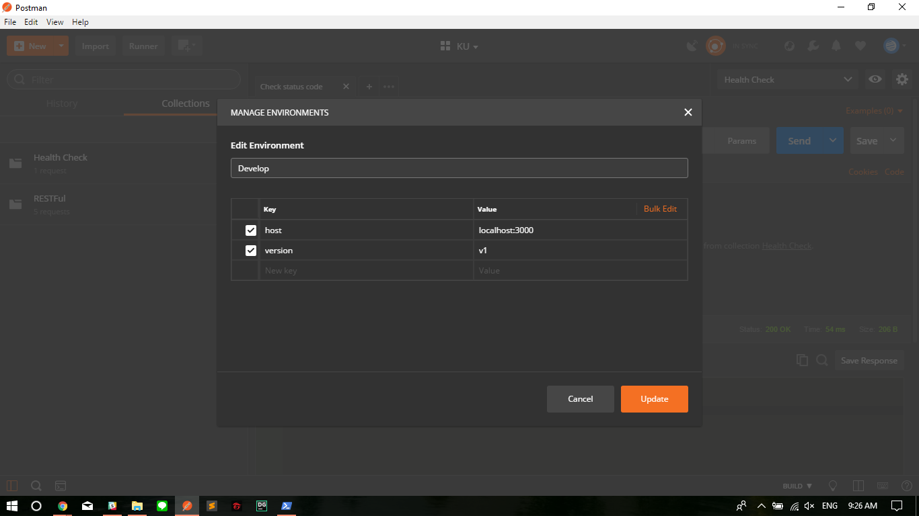
Postman

Slide 11
Postman
Create New Workspace
Manage Environment
Create Collection
Create Request
Export and Share Collection
Publish API Document
Write Tests
Mock Request

Slide 12
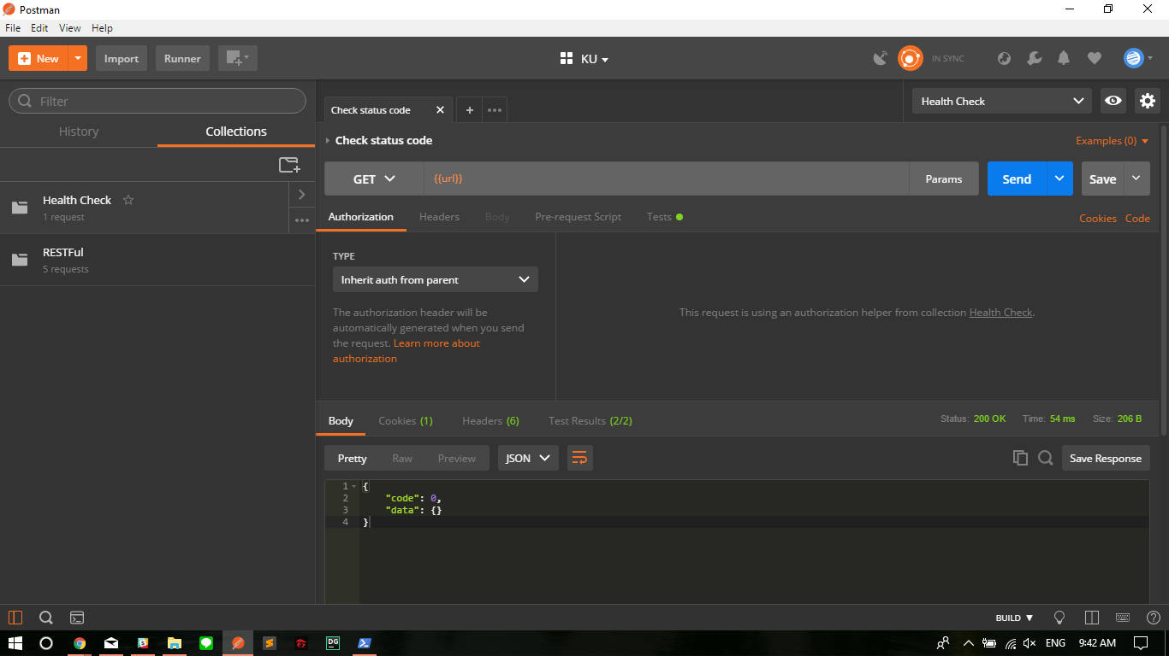
Notes:
พยายาม ให้ใส่ Description ให้ครบ

Slide 13
Postman
Create New Workspace
Manage Environment
Create Collection
Create Request
Export and Share Collection
Publish API Document
Write Tests
Mock Request

Slide 14
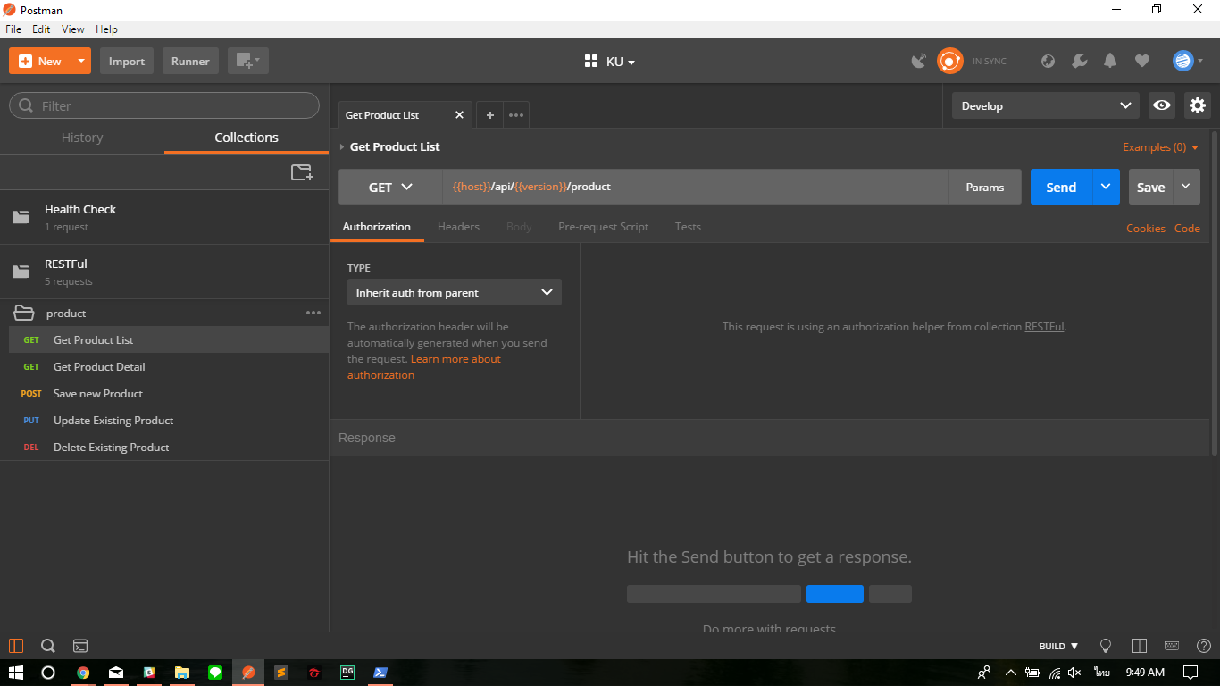

Slide 15
Postman
Create New Workspace
Manage Environment
Create Collection
Create Request
Export and Share Collection
Publish API Document
Write Tests
Mock Request

Slide 16
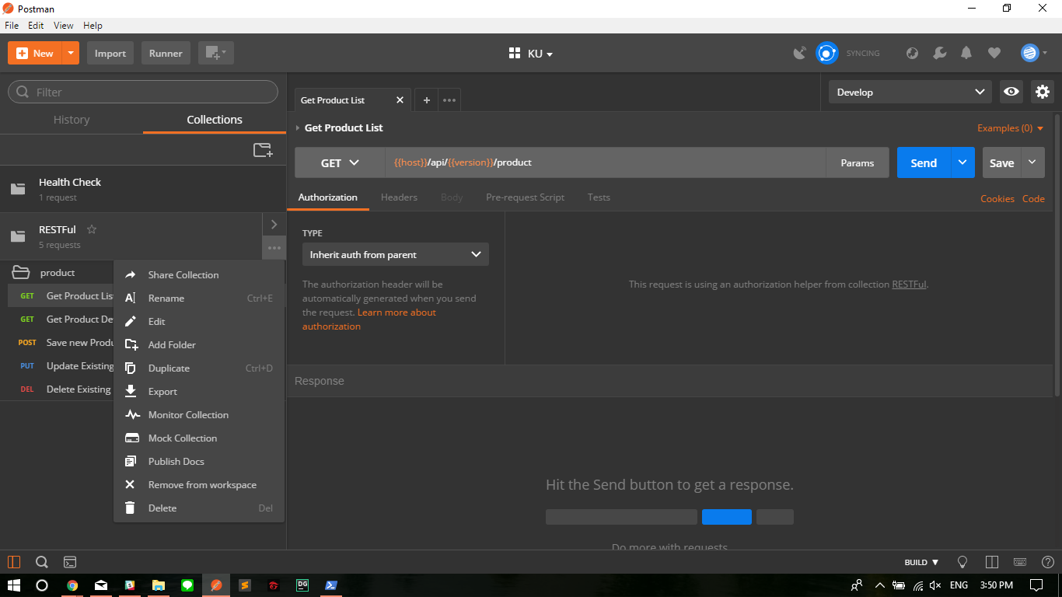

Slide 17
Postman
Create New Workspace
Manage Environment
Create Collection
Create Request
Export and Share Collection
Publish API Document
Write Tests
Mock Request

Slide 19
Postman
Create New Workspace
Manage Environment
Create Collection
Create Request
Export and Share Collection
Publish API Document
Write Tests
Mock Request

Slide 20
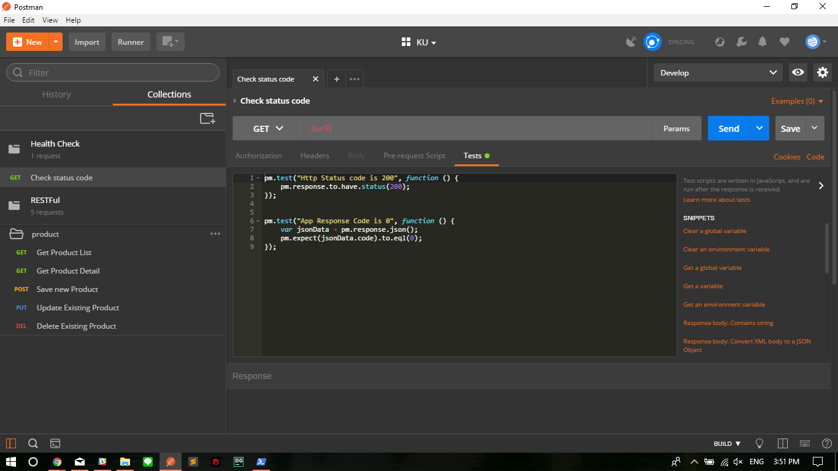

Slide 21
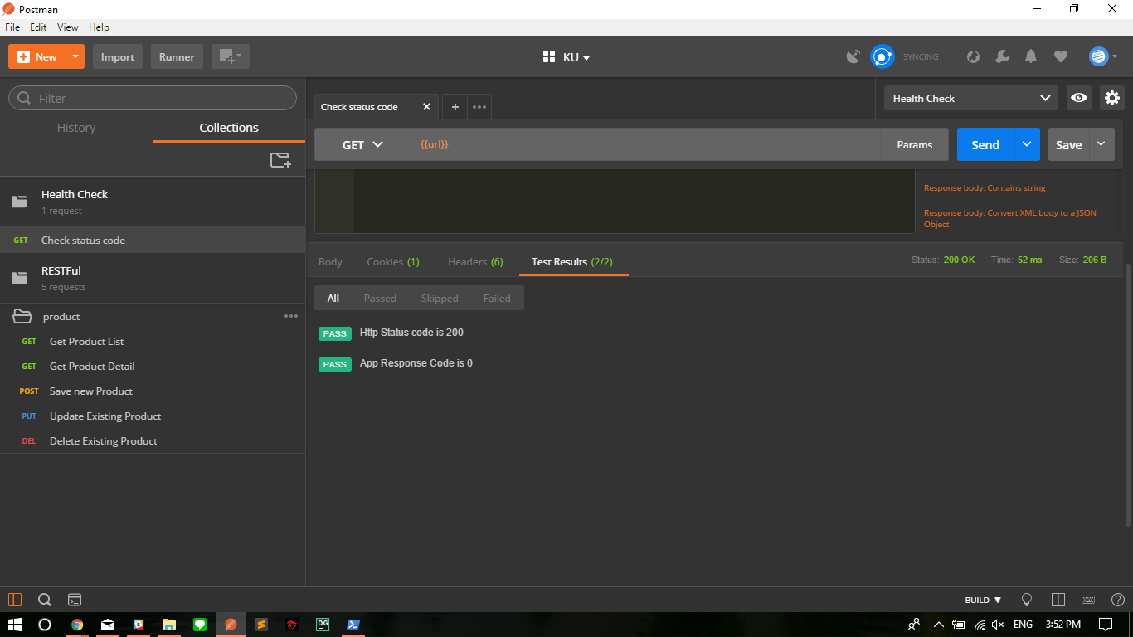

Slide 22
Postman
Create New Workspace
Manage Environment
Create Collection
Create Request
Export and Share Collection
Publish API Document
Write Tests
Mock Request

Slide 23
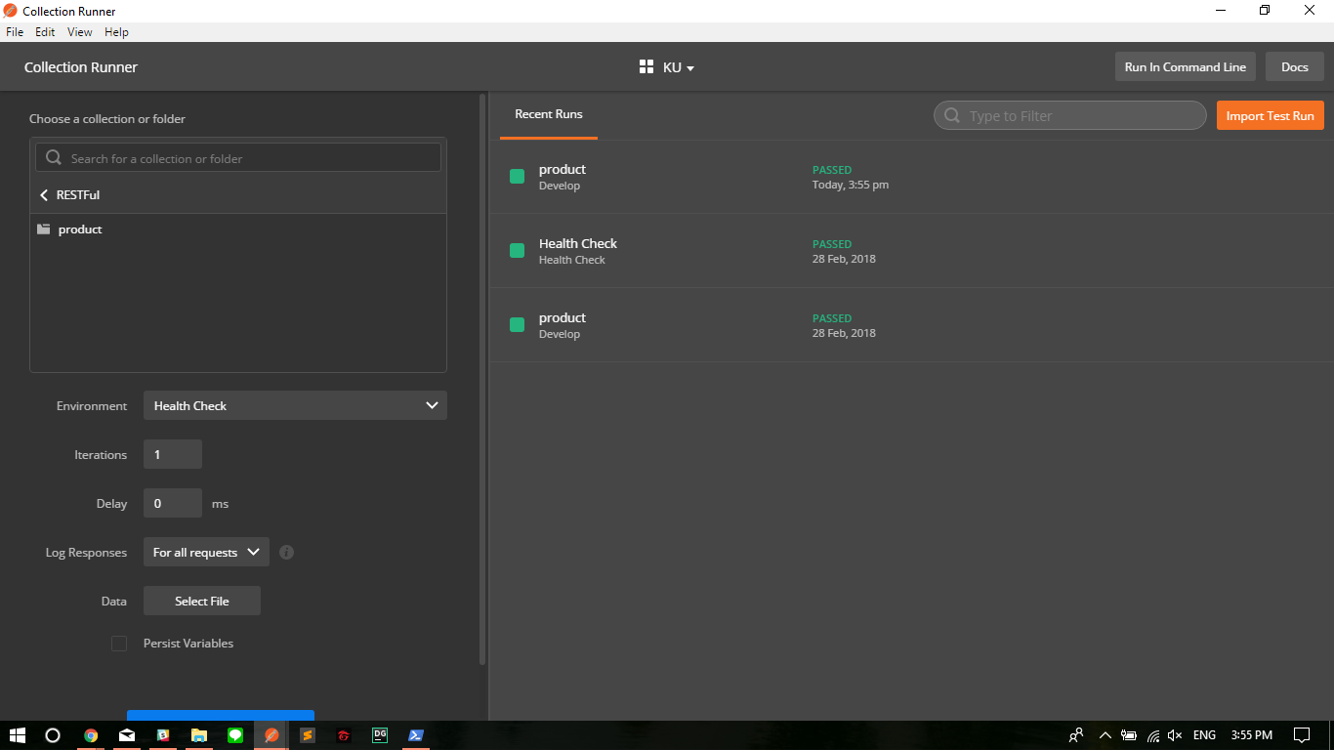
Notes:
Runner Menu
ลงไม่ค่อยลึก บอกแค่ว่ามันทำได้ แต่ติดเพราะยังไม่อัพเกรดให้กลายเปน Pro Version

Slide 24
Postman
Pre-Requisite
git clone https://github.com/csithdev/ku_backend.git
npm install nodemon -g
Go into /ku_backend
npm install
node start

Slide 25
Postman
Lab 01
Create Dev / Sys / Prod Environment
Create RESTful “Product” Collection with Requests
Write Tests
Commit to Git Repo
Write README link with Publish API Document

Slide 26
Slack
Features
Team Instant Messaging
Cross-Platform support
Plenty of APIs
Many Integration available
Slack Bot :)
Notes:
https://slack.com/features

Slide 27
Slack
1. Create or Join Workspace

Slide 28
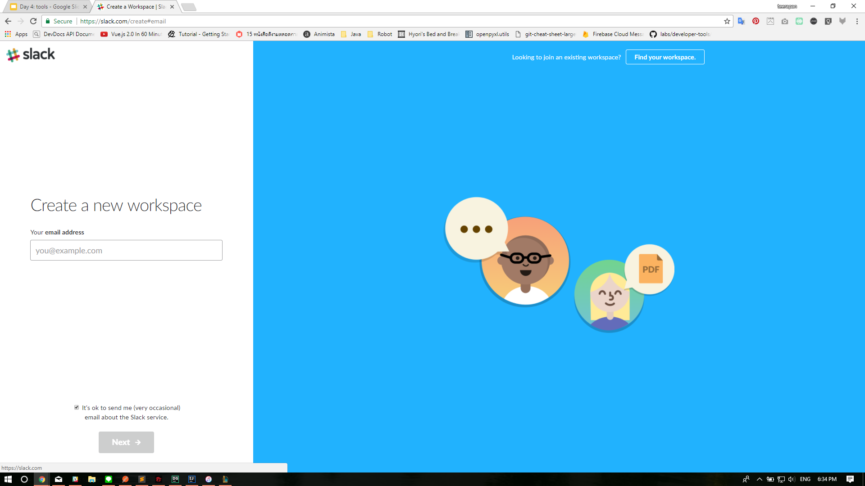

Slide 29
Slack
2. Invite all the people

Slide 30
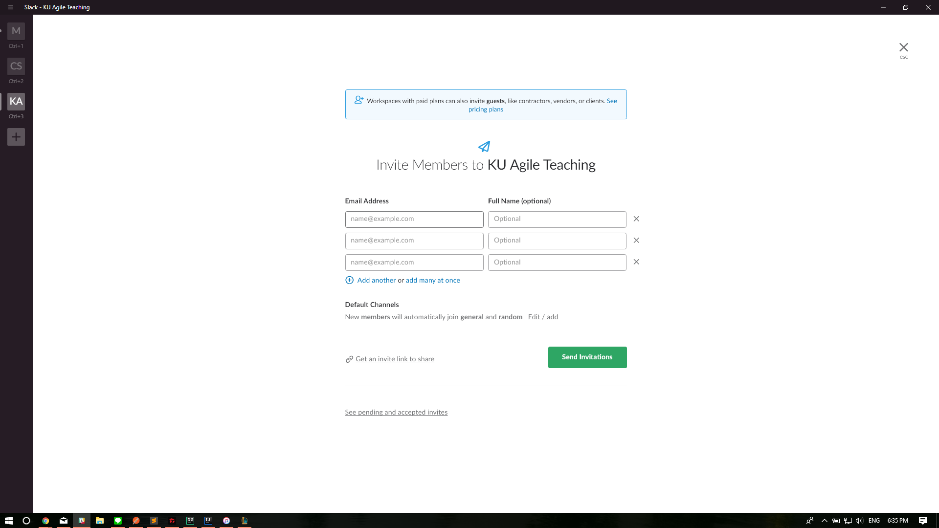

Slide 31
Slack
3. Start using Slack!

Slide 32
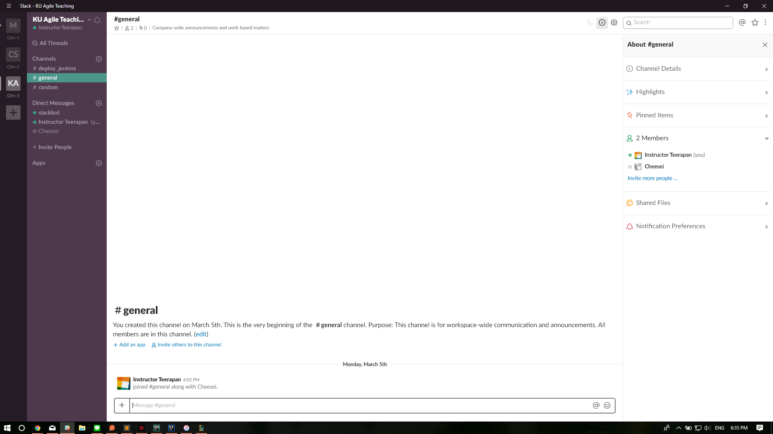

Slide 33
Slack
More Setting
Setting & Permission
Customize your workspace
** Integrating Apps and Customizing it
You can even build your own apps! (Documentation: https://api.slack.com/)
Notes:
Sample
DailyMeeting
Simple Poll
Geekbot
Jenkins
Trello
Build Documentation
https://api.slack.com/

Slide 34
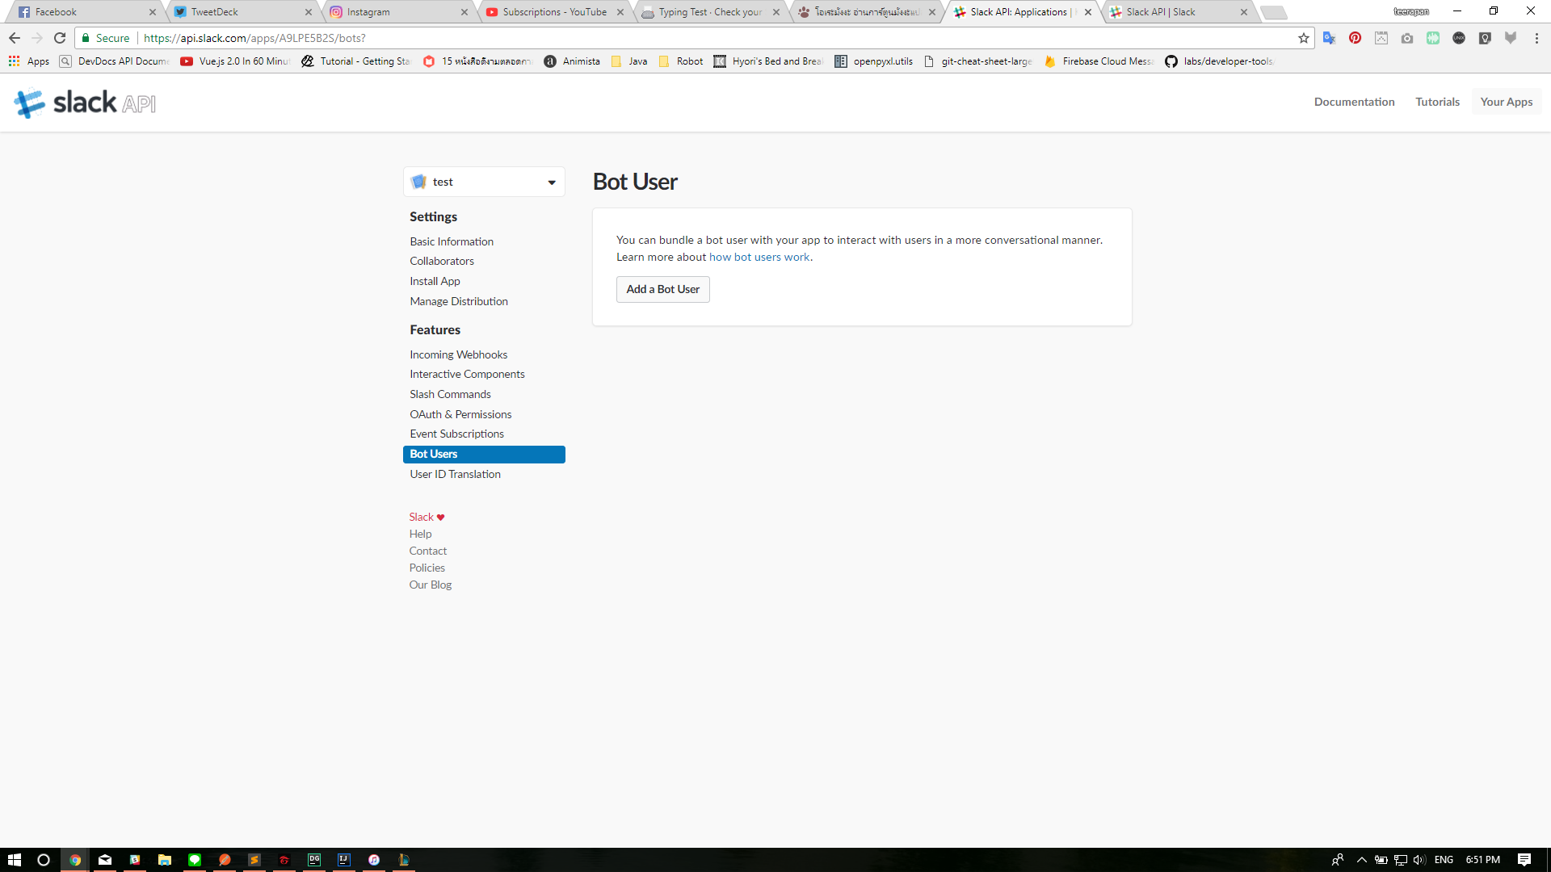
Notes:
https://api.slack.com/apps

Slide 35
Trello
https://trello.com

Slide 36
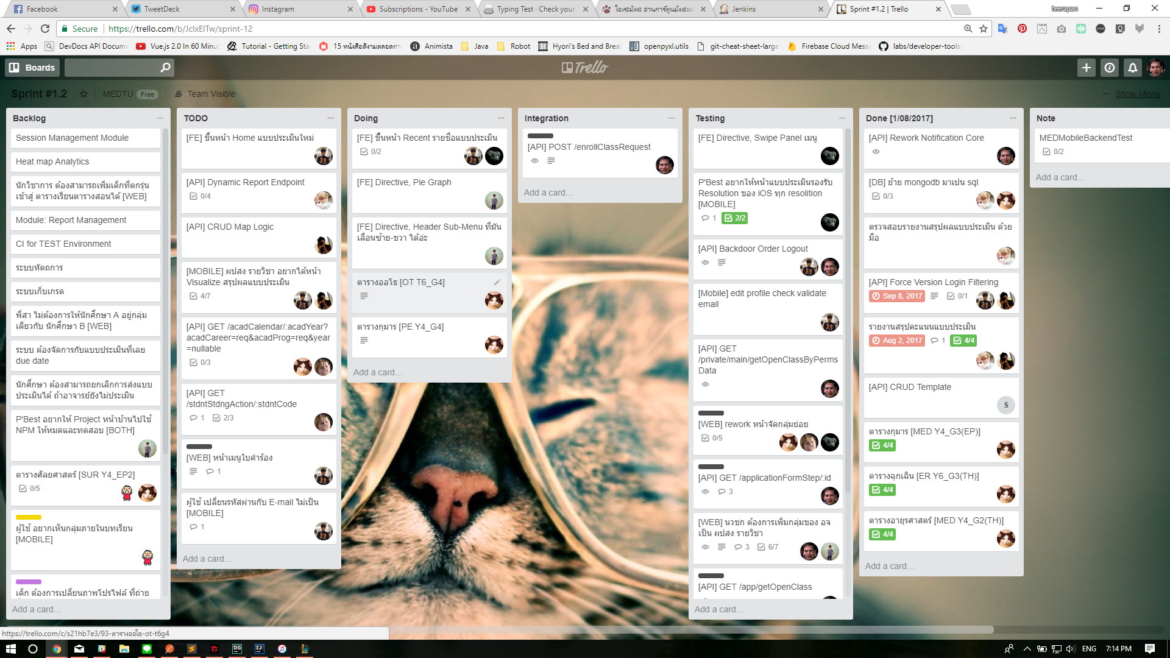

Slide 37
Jenkins
What is CI/CD?
What is Jenkins?
Why do we use it?

Slide 38
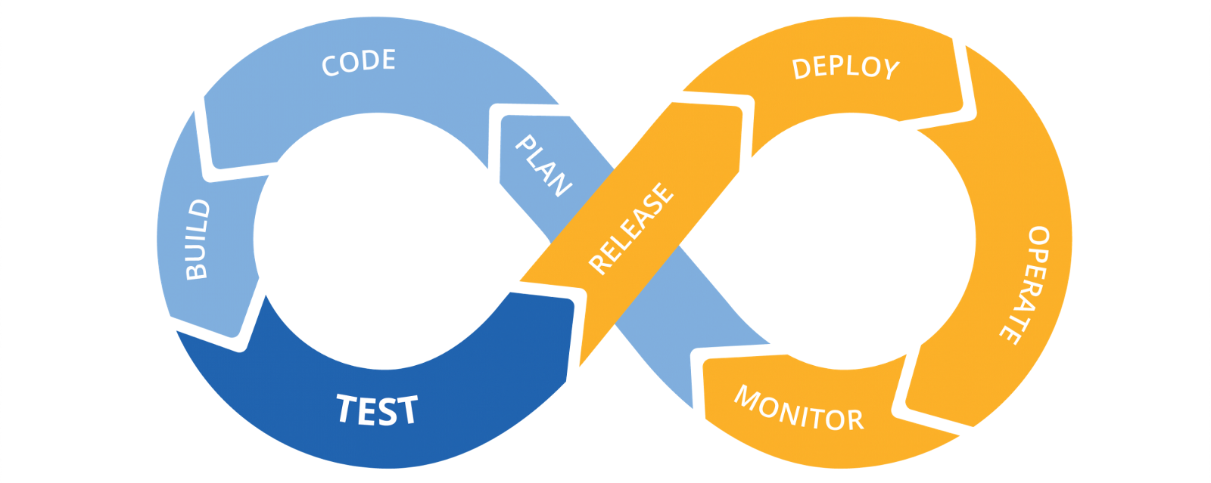
CI/CD

Slide 39
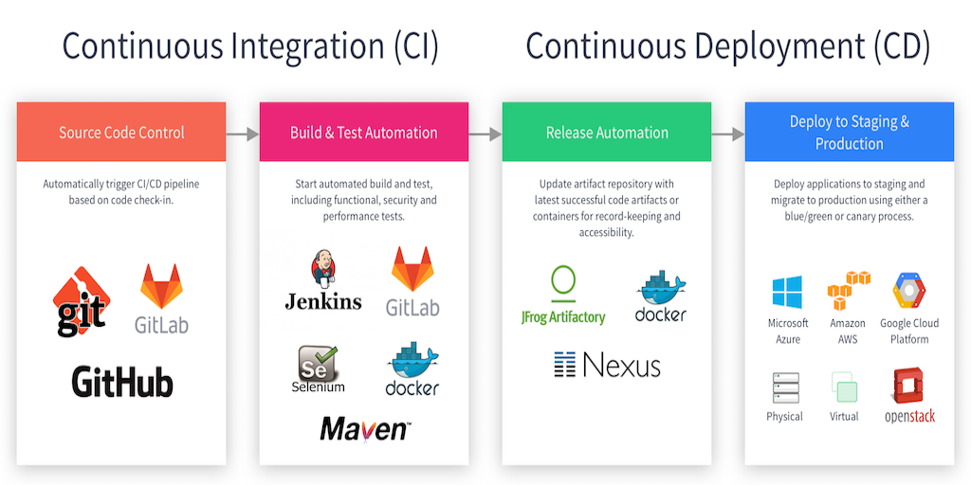
CI/CD

Slide 40
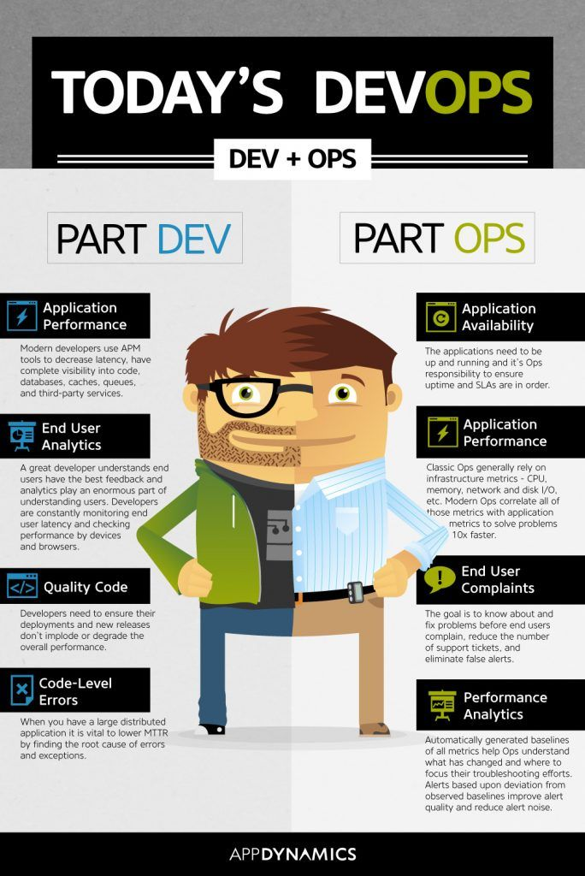

Slide 41
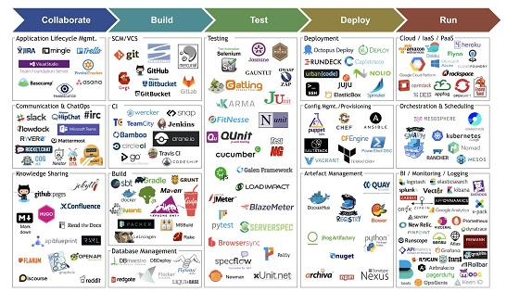
DevOps

Slide 42
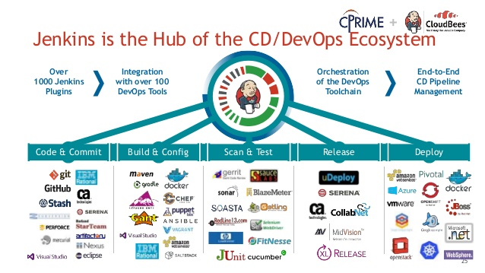
Jenkins
Notes:
The leading open source automation server, Jenkins provides hundreds of plugins to support building, deploying and automating any project.

Slide 43
Jenkins
Installation
Start your Docker
Pull jenkins images from , https://hub.docker.com/r/jenkins/jenkins/
Start your Container with jenkins images
Configure your Jenkins

